Slide 1
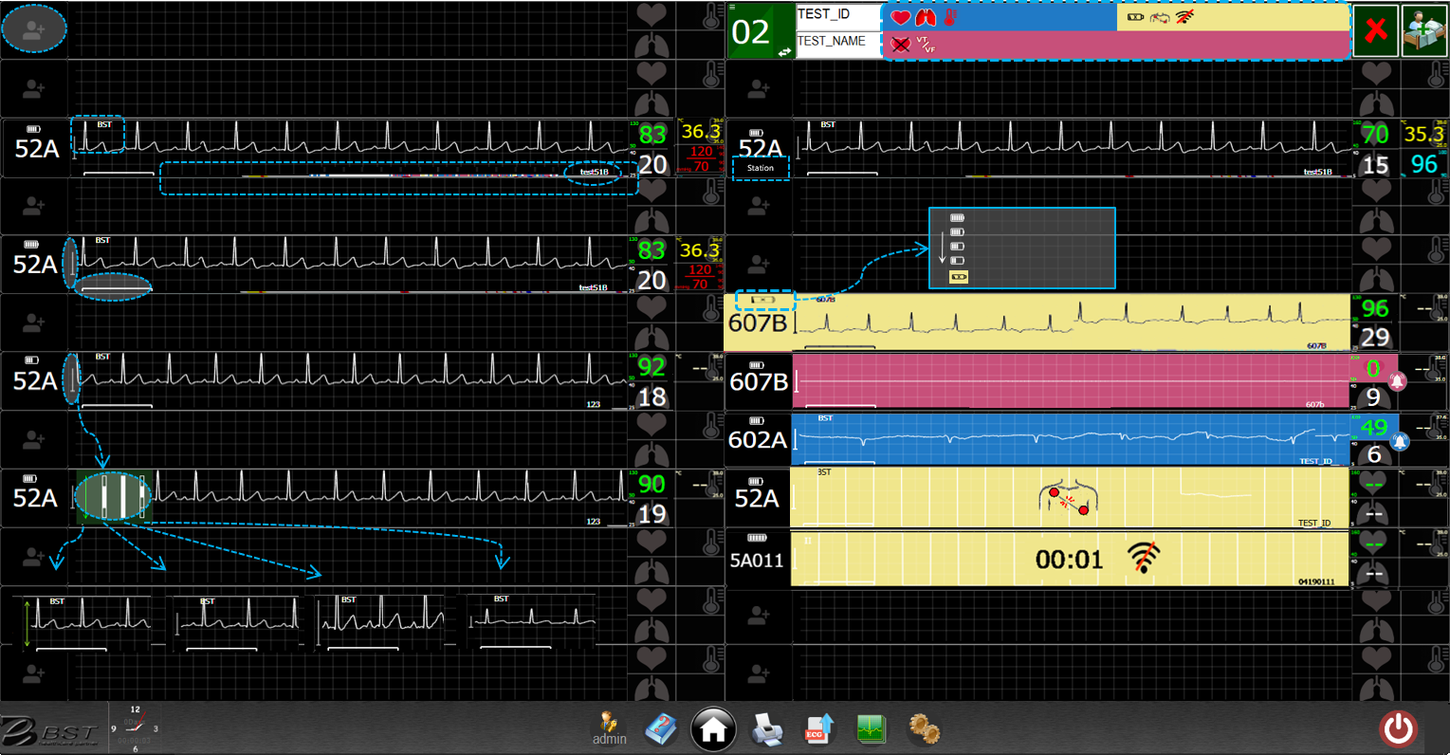
Real-Time Mode
Blue: heart rate, respiration, or temperature exceed/below the limit
Yellow: battery status, lead off, connection failure
Red: asystole, VT, VF
Click to Start
Patient ID
HR
Temp.
Patient Name
Click
for setting
One-hour status bar
Gain
Location
(while roaming)
H
Battery Level
RR
SpO2/ BP
(External)
L
Please recharge within 8 hours.
Time = 1 sec
Click to adjust display gain
Asystole (Red)
Below the alarm limit (Blue)
Click to select (a), (b), (c), or (d)
Lead off (Yellow)
Connection failure
(Yellow)
(a) auto
(b) 1mV (default)
(c) 2 mV
(d) 0.5 mV
User manual
Home
Retrieve
Current time
Sign in
Setting
Exit
Print all patients’ latest 8 sec. waveforms

Slide 2
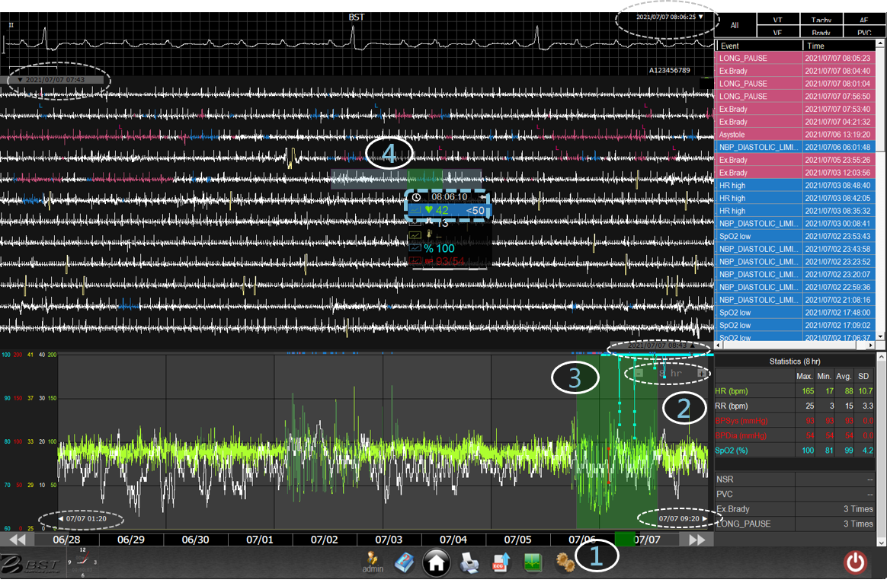
Retriever Mode
(review data history)
End time of standard waveforms (15 sec)
Start time of one-hour waveforms
Move the green block to display standard waveforms
(white block: print region)
Time & vital signs of standard waveforms
End time of one-hour waveforms
Click to display selected vital sign in trend
Move the green block to display one-hour waveforms
Move/click the full time scale to select time region of trend
Trend duration zoom in/out (1/8/24/120 hr)
Start time of trend
End time of trend
Print standard waveforms
Print statistical report

Slide 3
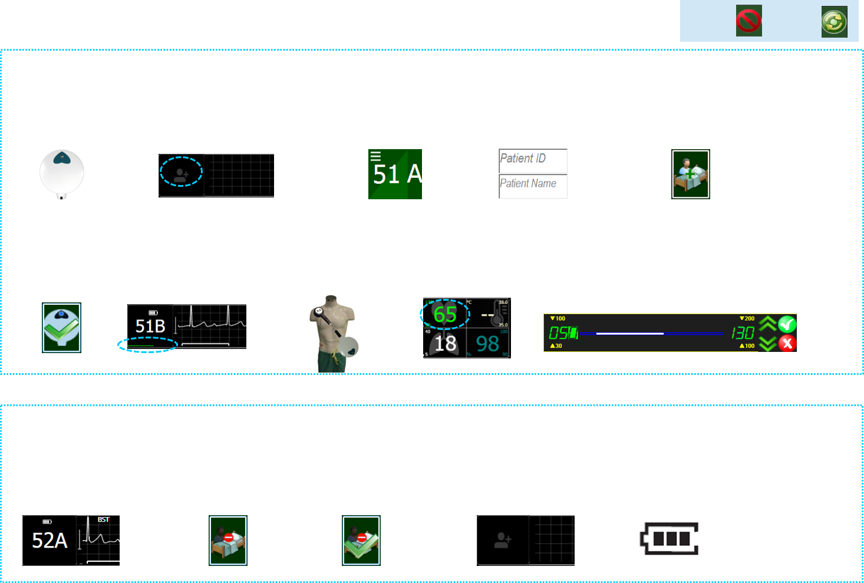
Cancel
Retry
Admission
Press “heart” to power on
Click on any blank region to begin
Select ward/bed #
Enter patient ID (*required) and name
Click to admit
*Required
Click to confirm
10 sec testing signals
Snap two electrodes and stick to patient
Click to set the upper/ lower limit
Click on a digit
Click increase/ decrease
Click on confirm (V)/ cancel (X)
Discharge
Click on the ward/ bed # to continue
Click on the discharge icon
Click to confirm
Discharge completed
Take off the transducer and recharge
Notes:
To Check:
15sec測試訊號？

Slide 4
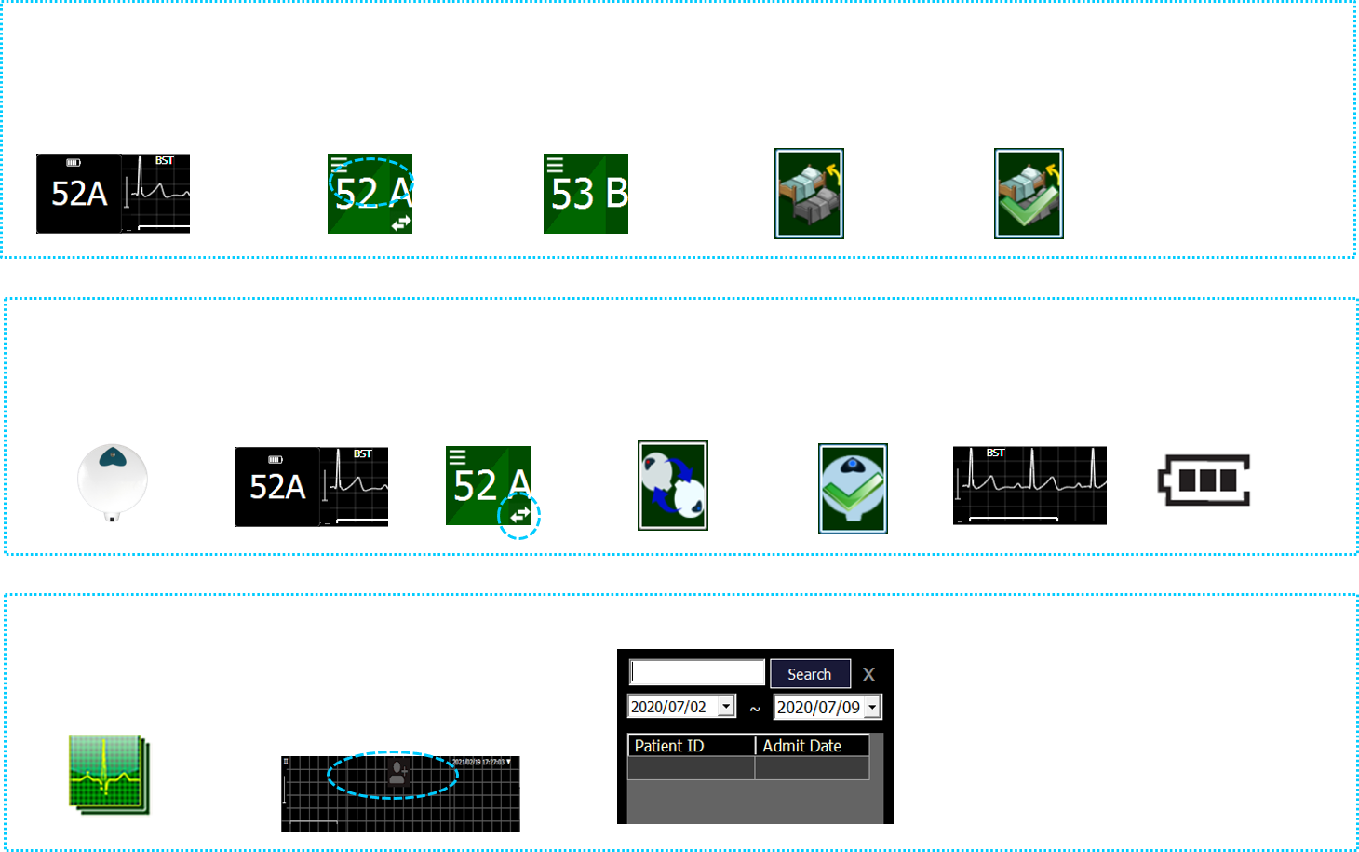
Transfer
Click on the ward/ bed #
Click on the ward/ bed #
Select a new ward/ bed #
Click to transfer
Click to confirm
Transducer Swap
Press the” heart” on the new transducer
Click on the ward/ bed # to continue
Click to swap transducer
Click to swap
Click to confirm
Monitor with the new transducer
Recharge the used transducer
Retrieve (Discharged)
Click retrieve icon (menu bar) to load retriever
Choose one of the options below:
Input patient ID.
Set possible admission time range.
Input keyword of patient ID.
Input keyword of patient ID and set possible admission time range.
Click Search button to search.
Click to retrieve
Notes:
To Check:
15sec測試訊號？

